Slide 1

The Comboni Fullstack Website
A Robust Platform for Modern School Management and Community Engagement
This presentation outlines the architecture, capabilities, and strategic value of the Comboni Fullstack Web Application, a solution designed to streamline school administration, enhance transparency, and create stronger community connections.

Slide 2
Project Overview and Core Technology
1
2
3
Project Foundation: Django
Frontend Presentation: HTML & CSS
Interactivity Layer: Python & JavaScript
Built on the robust and secure Django framework, providing rapid development and a scalable backend for handling complex data models and authentication.
These technologies form the core structure and visual styling, ensuring a custom, branded, and responsive user interface across all devices.
Python (Django) manages server-side logic and data. JavaScript adds dynamic interactivity, theme toggling, and real-time data visualization on the frontend.

Slide 3

Project Detail
Full Tech Stack:
App Structure:
Front end: HTML, CSS and JS
Backend: Python (Django)
DB: Sqlite3
Websocket: Django channels
Project is split into logical Django apps.
a_message for realtime chat
a_student, a_teacher and a_school_admin for roll based features and permission.
a_visitor for public viewer using the app
System Architecture is Monopolic
Main Purpose:
Real-Time features
The sites main goal is to make the teacher and learning process of a school fast, repayable and automated making it centralized data system with security in mind
Using websocket via Django channels and Daphne for news and live chat

Slide 4




Strategic Value: Solving Core School Challenges
The primary purpose of this platform is to provide an interactive, centralized hub for all key school stakeholders, addressing critical needs in management and outreach.
Streamlined School Administration
Enhanced Community Engagement
Enables comprehensive digital management of classes, student records, teacher allocations, and extracurricular activities, significantly reducing reliance on manual processes.
Serves as a powerful outreach tool by showcasing school features, academic excellence, and authentic student testimonials to the wider community and prospective families.
Optimized User Experience (UX)
Features dedicated interfaces for both public visitors and authenticated administrators, ensuring relevant information and tools are easily accessible to the correct user groups.

Slide 5






The Visitor Portal: School Showcase and Outreach
The public-facing portal is designed to be the digital face of Comboni Senior Secondary School, emphasizing visual appeal and ease of navigation to engage visitors and build school pride.
Home Page Highlights
Authentic Testimonials
Responsive and Accessible Design
Presents key selling points such as Academic Excellence, Community Engagement initiatives, and Innovative Learning methods, setting a clear institutional vision.
Integrates genuine testimonials from current students, adding credibility and a human element to the school's features and successes.
Custom CSS ensures the site is visually appealing and fully responsive across all screen sizes (mobile, tablet, desktop), guaranteeing a consistent experience.

Slide 6
Admin Dashboard: Control and Insight
The secure Admin Dashboard is the operational core of the application, providing school administrators with the tools necessary for efficient data management and decision-making.
Centralized Class Management
Performance Visualization
Tools allow for creating, updating, and managing classes, tracking student enrollment, and assigning teaching staff. This feature centralizes all logistical data.
Integration of Chart.js allows administrators to view critical performance metrics and class activity through dynamic, easy-to-read charts, replacing cumbersome spreadsheets.
Usability and Customization
Secure Authentication
The dashboard offers theme toggling (light/dark mode) and sidebar customization, allowing individual administrators to tailor the interface for optimal usability and comfort.
Robust Django authentication handles secure login, logout, and password management, ensuring sensitive school data is protected from unauthorized access.

Slide 7






Frontend Development & Rich Interactivity
The front-end design prioritized modern aesthetics, accessibility, and dynamic interaction through strategic use of custom and third-party libraries.
Key Frontend Components
Custom CSS: Applied for precise branding, responsive design, and maintaining a unique, modern visual identity that reflects the school's quality.
JavaScript Functionality: Powers client-side theme switching and controls the responsive menu sidebar, enhancing navigation and user control.
Template Inheritance: Leveraging Django’s templating system for reusable UI components (e.g., header, footer, dashboard fragments), ensuring consistency and efficient development.
Strategic Library Integration
External libraries were carefully selected to add functionality without compromising performance:

Slide 8

Backend Architecture: Stability and Security with Django
Django serves as the powerful engine driving the application. Its batteries-included philosophy ensures a secure, maintainable, and scalable backend infrastructure.
Server-Side Logic
All business logic, data processing, and complex interactions are managed securely on the server via Python and the Django framework.
Robust Data Management
Utilizes Django's ORM (Object-Relational Mapper) for database interaction, ensuring data integrity and simplifying secure storage and retrieval.
Migration Handling
The architecture includes initial migration files, confirming the proper setup for evolving the database schema without data loss as the application grows.
Authentication & Permissions
Leveraging Django's built-in secure authentication system to manage user roles (admin, teacher, student) and permissions effectively.

Slide 9
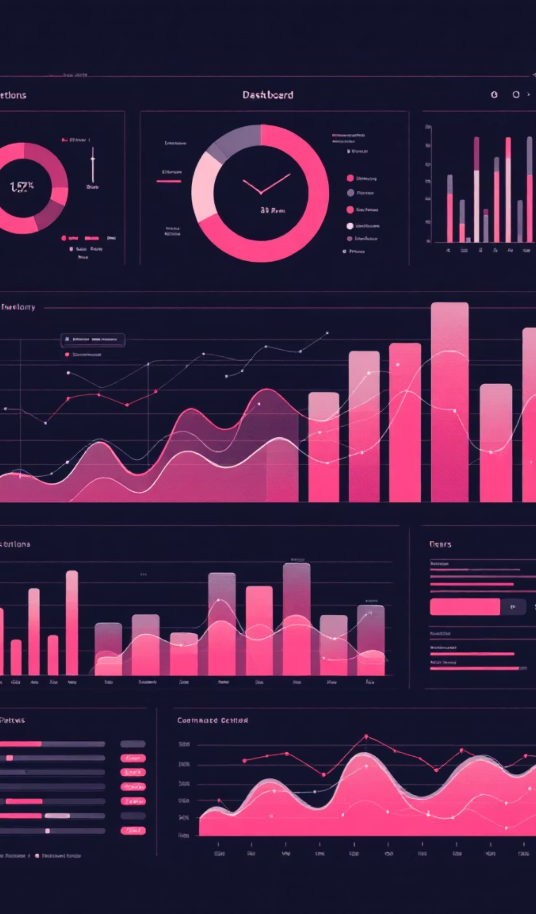





Data Visualization: Transforming Data into Actionable Insights
A critical feature of the admin dashboard is the use of dynamic charts to make complex data easily comprehensible, promoting data-driven decision-making.
Processing
Interpretation
Data Storage
Visualization
Data is not just stored; it is presented visually to help staff understand trends in student performance and resource allocation quickly.
Visualization elements utilize Chart.js to render class activity, attendance rates, and performance metrics, turning raw data tables into insightful graphical summaries.

Slide 10




Why This Matters: Impact and Scalability
The Comboni website is more than a digital presence; it is a foundational tool for institutional improvement and future growth.
Scalability
Built on modular Django architecture, the platform is designed to easily accommodate new features, greater user load, or integration with other school systems.
Operational Efficiency
Digitizing core school operations drastically reduces the manual workload for administrative staff, allowing them to focus on higher-value tasks.
Transparency
Makes school data and performance metrics readily accessible and visual for all authorized stakeholders, fostering trust and informed collaboration.
Building Community
The platform actively connects students, staff, parents, and visitors, reinforcing a unified school culture and extending its reach.

Slide 11



Summary and Next Steps
The Comboni Fullstack Website is a robust, interactive platform that successfully manages school operations and serves as a powerful engagement tool.
Key Takeaways
Fullstack Proficiency: Demonstrates strong command over both backend (Django/Python) and modern frontend technologies.
User-Centric Design: Features distinct, responsive portals for different user roles (visitor, admin).
Data-Driven: Integrates Chart.js and DataTables for effective visualization and management of school performance data.
Ready for Extension: Modular design supports future expansion, such as adding parent portals or advanced student information systems.
We are confident that this solution provides the foundation for a highly effective and modern digital school ecosystem.

